Slide 1
Chapter 11
How to work with images and icons

Slide 2
Objectives
Applied
Use HTML to include images on a web page and CSS to align and float images.
Use the HTML5 figure and figcaption elements to treat an image as a figure.
Use HTML to create an image map that can be used to link to more than one web page.

Slide 3
Objectives (continued)
Knowledge
List and describe the four types of images that are used with websites.
Describe the proper use of the img element and its related CSS.
Describe the use of the figure and figcaption elements with images.
Describe the use of the picture and source elements for working with images.
Describe the use of image rollovers and image maps.
Describe the use of image editors and tools for creating favicons.
Describe the use of the svg element and Scalable Vector Graphics.

Slide 4
Image types
GIF
JPEG
PNG
WebP
SVG

Slide 5
Attributes of the <img> tag
src
alt
height
width

Slide 6
CSS properties for sizing an image
height
width

Slide 7
The HTML and CSS for two images
The HTML
<p><img src="images/students.jpg" alt="teacher and students"
height="300" width="400">&nbsp;&nbsp;
<img id="small" src="images/students.jpg" alt="teacher and students"></p>
The CSS for resizing the second image
#small {
height: 150px;
width: 200px; }

Slide 8

The images in a web browser

Slide 9
Accessibility guidelines
For images with useful content, always code an alt attribute that describes the content.
For images that are used for decoration, code the alt attribute as an empty string.

Slide 10
The property for aligning images vertically
vertical-align
Common keywords for this property
bottom
middle
top
text-bottom
text-top

Slide 11
The HTML and CSS for three images
The HTML
<h2>We want to hear from you</h2>
<p><img src="images/computer.gif" alt="web address">
<strong>Web:</strong> www.murach.com</p>
<p><img src="images/telephone.gif" alt="phone">
<strong>Phone:</strong> 1-800-221-5528</p>
<p><img src="images/email.gif" alt="email">
<strong>Email:</strong> murachbooks@murach.com</p>
The CSS that aligns the images
img {
vertical-align: middle;
margin-right: 10px; }

Slide 12

The images in a web browser before they’re aligned

Slide 13

Three images in a web browser after they’re aligned

Slide 14
The properties for floating images
float
clear

Slide 15
Some of the HTML for a web page
<img src="images/students.jpg" alt="teacher and students">
<ul>
<li>in college and university MIS programs that focus on providing students with practical, real-world experience</li>
<li>by technical institutes and community colleges that focus on the skills that employers are looking for</li>
<li>... </li>
</ul>
<p id="last">...</p>

Slide 16
The CSS for floating an image and clearing the last paragraph
img {
float: left;
margin-top: 15px;
margin-bottom: 10px; }
#last { clear: left; }

Slide 17

The HTML in a web browser

Slide 18
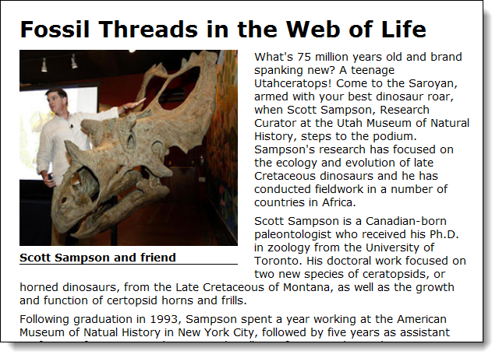
A page with figure and figcaption elements

Slide 19
The HTML for the figure and figcaption elements
<article>
<h1>Fossil Threads in the Web of Life</h1>
<figure>
<img src="images/sampson_dinosaur.jpg" alt="Scott Sampson">
<figcaption>Scott Sampson and friend
</figcaption>
</figure>
<p>...</p>
</article>

Slide 20
The CSS for the figure and figcaption elements
figure {
float: left;
margin-right: 1.5em; }
figcaption {
display: block;
font-weight: bold;
padding-top: .25em;
margin-bottom: 1em;
border-bottom: 1px solid black; }

Slide 21
Elements for adding multiple picture resources
picture
source
img
Attributes of the source element
media
srcset
type

Slide 22
Displaying an image based on screen size
<picture>
<source media="(min-width: 960px)"
srcset="images/mountains01.png">
<source media="(min-width: 768px)"
srcset="images/mountains02.png">
<source media="(min-width: 460px)"
srcset="images/mountains03.png">
<img src="images/mountains04.png" alt="">
</picture>

Slide 23
Displaying an image in an alternative format
<picture>
<source type="image/webp"
srcset="images/mountains04.webp">
<img src="img/mountains04.png" alt="">
</picture>

Slide 24
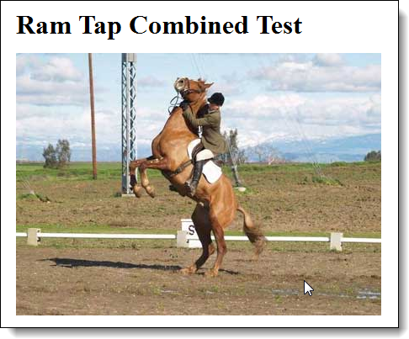
This image has been rolled over because the mouse is hovering over it

Slide 25
The HTML and CSS for an image rollover
The HTML
<body>
<h1>Ram Tap Combined Test</h1>
<p id="image1"></p>
</body>
The CSS for the image rollover
#image1 {
background-image: url("h1.jpg");
width: 434px;
height: 312px;
}
#image1:hover {
background-image: url("h2.jpg");
}

Slide 26

An image in a web browser with hotspots created by an image map

Slide 27
The HTML for the image and image map
<img src="images/web_books.jpg"
alt="PHP/MySQL and JavaScript/jQuery books"
usemap="#books">
<map name="books">
<area href="php_mysql.html"
shape="poly"
alt="PHP/MySQL book"
title="PHP/MySQL"
coords="0,30,115,0,133,67,109,156,39,174">
<area href="javascript_jquery.html"
shape="poly"
alt="JavaScript/jQuery book"
title="JavaScript/jQuery"
coords="145,21,261,52,222,195,107,165">
</map>

Slide 28
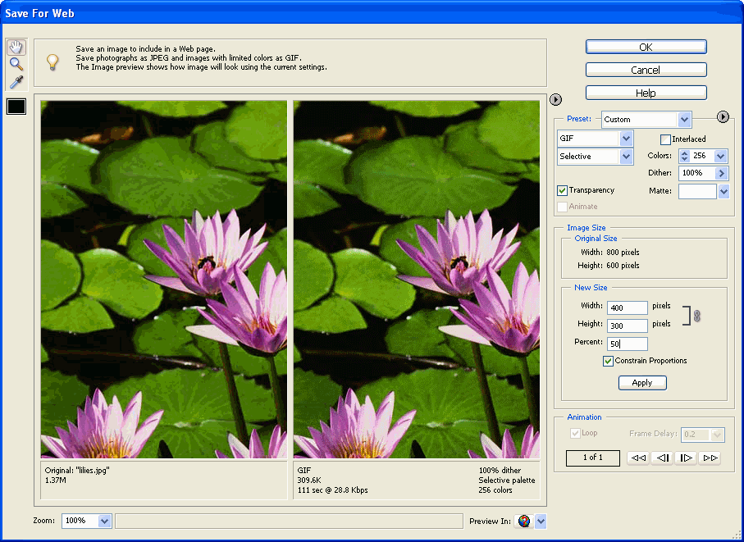
An image editor

Slide 29
Typical editing operations
Change the size, image type, or quality of an image.
Control the animation of an animated GIF file.
Save an image with transparency or a matte.
Get the coordinates for an image map.

Slide 30

An image without transparency and with transparency and a matte

Slide 31
Creative Commons license conditions for images and icons
Attribution
Share Alike
Non-Commercial
No Derivative Works

Slide 32
Popular icon libraries
Font Awesome
Glyphicons
Glyphish
Material Icons
Flaticon

Slide 33

HTML that uses 3 Font Awesome icons
<h2>We want to hear from you</h2>
<ul>
<li><i class="fas fa-globe fa-lg"></i> <strong>Web:</strong> www.murach.com</li>
<li><i class="fas fa-phone-square fa-lg"></i> <strong>Phone:</strong> 1-800-221-5528</li>
<li><i class="fas fa-envelope-square fa-lg"></i> <strong>Email:</strong> sales@murach.com</li>
</ul>
The icons in a web browser

Slide 34
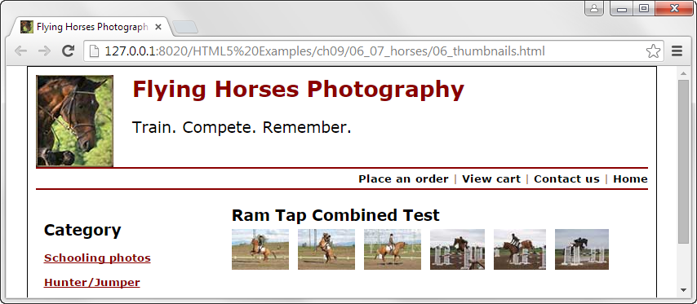
A web page with a favicon
The link element that links to the favicon
<link rel="shortcut icon" href="images/favicon.ico">

Slide 35
Popular programs and tools for creating favicons
Axialis Icon Workshop
Font Awesome
Photoshop plugin
IrfanView
FavIcon from Pics

Slide 36
How to work with Scalable Vector Graphics
Common attributes of the <svg> element
height
width
x
y
Child elements for creating various shapes
rect circle ellipse line polyline polygon
path text
How to create a red rectangle with a black border
<svg>
<rect width="300" height="100"
fill="red" stroke="black" />
</svg>

Slide 37

The Murach logo as an SVG element
<svg viewBox="0 0 247.83 76.96">
<rect class="cls-1" width="80" height="76.96"/>
<path class="cls-2"
d="M28.19,18.36H18.13s3.29.09,3.29,4.33V52l10.53-
3.33V22.47C31.95,19.88,30.58,18.37,28.19,18.36Z"/>
<path class="cls-2"
d="M40.33,21.9H30.26s3.29.08,3.29,4.32V55.52l10.53-
3.33V26C44.09,23.43,42.72,21.91,40.33,21.9Z"/>
<path class="cls-2"
d="M52.42,25.53H42.36s3.29.08,3.29,4.32V59.14l10.53-
3.33V29.64C56.18,27.05,54.81,25.54,52.42,25.53Z"/>
</svg>
The logo

Slide 38
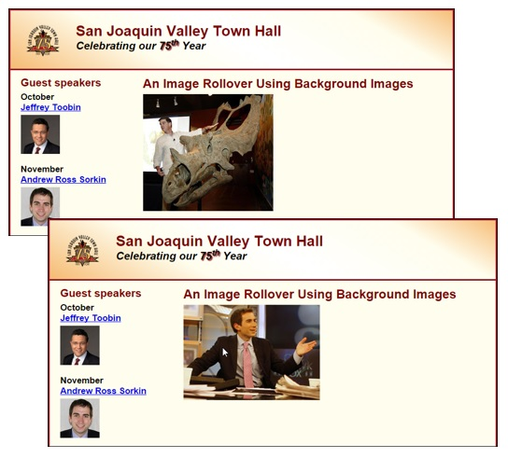
Short 11-1 Do an image rollover with CSS

